Slide 1
Communications API
Notes:
HTML5 defines several important extensions to the way in which Web browsers and Web servers communicate with each other. Collectively, these extensions are called the Communications API.
These extensions go far beyond tags and JavaScript APIs. They have a profound architectural effect on the way you construct enterprise-level Web applications.

Slide 2
Contents
Key principles
Cross-document messaging
Ajax XMLHttpRequest Level 2
Demos folder:
Demos\15-CommunicationsApi
Notes:
Section 1 summarizes the features covered in the Communications API, and explains why these new features are necessary.
Section 2 explains the concept of cross-document messaging, which allows portions of a Web page to communicate with each other even if they originated from different domains.
Section 3 introduces extensions to Ajax, collectively known as Ajax Level 2. These are game-changing enhancements to the way you use Ajax in your Web applications.

Slide 3
1. Key Principles
Overview of cross-domain messaging
Overview of Ajax XMLHttpRequest level 2
Understanding origins
Notes:
HTML5 provides two important mechanisms for real-time communication
Cross-domain messaging
Ajax XMLHttpRequest Level 2
We'll summarize both techniques in this section, and then explore the details in the rest of the chapter.

Slide 4
Overview of Cross-Domain Messaging
Allows HTML5 applications from different domains to communicate safely with each other
Overcomes previous security limitations enforced by browsers…
Which prevented programmatic access to other frames etc.
Typical usage scenario:
Communication between widgets in a mash-up (portal)
Allows secure cross-origin communication across iframes, tabs, and windows
Based upon the postMessage() function
See section 2 in this chapter for details
Notes:
Prior to HTML5, if a Web page contained portions (e.g. iframes) downloaded from different domains, it was forbidden for the two portions to communicate with each other.
This security constraint has changed in HTML5, so that documents in a Web page can opt-in to messages from other documents in the same Web page, even if the documents came from a different origin.

Slide 5
Overview of XMLHttpRequest Level 2
XMLHttpRequest is the workhorse of Ajax applications
Allows a client to send asynchronous requests to a Web server on the same domain
The client can define call-back functions to receive results when ready, and then update the UI smoothly
HTML5 takes XMLHttpRequest to a new level
Level 2, in fact ☺
Supports cross-domain calls
Also provides a better progress-update mechanism
Based upon the XMLHttpRequest object
See section 3 in this chapter for details
Notes:
Ajax Level 2 has two main enhancements over regular Ajax:
Ajax Level 2 allows a Web page to make Ajax calls to different domains than the one from which the Web page was downloaded in the first place.
Ajax Level 2 also has a more fine-grained event model, allowing a Web page to be notified of the progress of data upload operations. Previously, Ajax only reported the progress of data downloads.

Slide 6
Understanding Origins
All the HTML5 communication APIs are based on the concept of an "origin"
An origin comprises:
A scheme (e.g. http, https)
A host (e.g. localhost, www.MyDomain.com)
A port number (e.g. 80, 8080)
Note: paths are not part of the origin
Thus the following two pages have the same origin
http://www.MyDomain.com/Customers/ViewCustomer.html
http://www.MyDomain.com/Products/ViewProduct.html
Notes:
The techniques describes on the previous slides are dependent on the concept of "origins". An origin is a combination of the scheme, host, and port number from which a Web page is downloaded.
Note that different Web folders and Web pages in the same domain are considered to be the same origin. See the example at the foot of the slide.

Slide 7
2. Cross-Domain Messaging
Scenario
Sending a message
Example of sending a message
Receiving a message
Example of receiving a message
Worked example
Notes:
In this section we're going to show a Web page that contains documents from different origins, and we’re going to show how the Communications API allows these documents to communicate with each other.

Slide 8
Scenario
In this section we'll explore cross-domain messaging between domains named mydomain1 and mydomain2
These domain name will actually just be aliases for localhost
To define these aliases, open a text editor as Administrator, open C:\Windows\System32\drivers\etc\hosts, and append:
Our example will involve two HTML files:
MyChatPortal.html
MyChatWidget.html
Copy these files to the IIS Web publishing folder
i.e. copy the files to C:\inetpub\wwwroot
127.0.0.1 mydomain1
127.0.0.1 mydomain2
Notes:
In order to run the example, you must have two different origins available. The instructions in the slide show how to set up two different origins on the same computer, named mydomain1 and mydomain2.
The example will download one web page from mydomain1, and will download the other web page from mydomain2.

Slide 9
Sending a Message
To send a message to another iframe, tab, or window…
Call postMessage() on the target window object
The postMessage() function takes two parameters
The message data you want to send
The target origin
aWindow.postMessage("some data", "http://www.MyDomain.com");
Set targetOrigin to:
The expected origin of target
Or * (if you don't care)
Or / (if must be same as sender)
Notes:
In order to communicate with a document that originated from a different domain, call postMessage() on the window to which you want to send the data.
Note that the second parameter allows you to specify allowable origins for the target document. In other words, you can insist that you only want to communicate with documents that came from specific places:
You can be very fussy, by specifying a particular URI.
You can allow any origin, by specifying "*".
You can insist that the document must originate from the same place as the current document, by specifying "/".

Slide 10
Example of Sending a Message
This example shows how a portal page can send a message to an iframe ("myWidget") within the page
See MyChatPortal.html
<script>
var targetOrigin = "http://mydomain2";
…
function sendStatusMessage() {
var statusMessage = document.getElementById("statusMessage").value;
document.getElementById("myWidget").contentWindow.postMessage(statusMessage, targetOrigin);
}
</script>
<input type="text" id="statusMessage" value="Online">
<button id="sendStatusMessageButton">Send Status Message</button>
<iframe id="myWidget"
src="http://mydomain2/…/MyChatWidget.html" … />
Notes:
This slide shows a complete example of how to send data to another window. The "other" window is an <iframe> that originated from a different domain, i.e. http://mydomain2.

Slide 11
Receiving a Message
To receive a message:
Handle the message event on your window
The event-handler function receives a message parameter
data property is the message data, obviously
origin property is the origin of the message sender
You should check the origin of the message sender, and possibly reject the message if unrecognized
This mechanism is safe!
The receiver has to opt-in to messages
Malicious pages can't hijack unsuspecting pages
Notes:
To receive a message, handle the message event as described in the slide. You can (and should) check the origin of the message, to see if it's an origin you trust. You always have the right to discard messages you don't like - this is where security comes into play.

Slide 12
Example of Receiving a Message
This example shows how a portal widget can receive a message (must be from a recognised origin)
See MyChatWidget.html
<script>
var targetOrigin = "http://mydomain1";
…
function onMessageReceived(e) {
if (e.origin === targetOrigin) {
document.getElementById("status").textContent = e.data;
} else {
alert("Widget ignoring message from unacceptable origin " + e.origin);
}
}
…
window.addEventListener("message", onMessageReceived, true);
</script>
Notes:
This slide shows a complete example of how to receive data, we only accept data that originated from http://mydomain1.

Slide 13
4. Ajax XMLHttpRequest Level 2
What's new?
How cross-origin requests work
Progress events
Checking for support
Worked example
Running the example
Notes:
Ajax Level 2 offers an improved API that allows you to make Ajax requests to different domains. It also has a more extensive event model, so that you can receive events indicating upload progress (not just download progress).

Slide 14
What's New?
XMLHttpRequest is enhanced in HTML5, in two important respects…
You can now make cross-origin requests
Known as "Cross Origin Request Sharing" (CORS)
Allows client-side (personalized) mash-ups from different domains
… rather than having to merge everything at the server, which can be a bottleneck
Much better progress notifications
XMLHttpRequest Level 1 progress notifications were a bit ad-hoc, and didn't give any progress on data uploads
XMLHttpRequest Level 2 raises named events that you can handle in a more consistent and standardized way
Notes:
This slide summarizes the new features available in Ajax Level 2. We'll explore both these features in this chapter.

Slide 15
How Cross-Origin Requests Work
Cross-origin HTTP requests have an Origin header
Provides the server with the request's origin
Provided by the browser, not spoofable from application code
The network equivalent of the origin property in message events
The CORS specification mandates that an OPTIONS preflight request be sent to the server by the browser
Determines whether the proposed action is supported and allowed
This implies you need a CORS-aware Web server
We're using Python in our example (you can easily download Python for free)
Notes:
Ajax cross-origin requests involve an HTTP Origin header and an OPTIONS HTTP message as described in the slide. The Web server must understand CORS, so we're going to use Python for demonstration purposes.

Slide 16
Progress Events
XMLHttpRequest Level 1 only had a single progress event, named readystatechange
Value indicated by readyState, ranged from 1 to 4
Inconsistently implemented
XMLHttpRequest Level 2 has the following named events, much better:
loadstart
progress
abort
error
load
loadend
Notes:
For full details about the events listed above, see:
http://www.w3.org/TR/XMLHttpRequest2/

Slide 17
Checking for Support
You can easily check for XMLHttpRequest Level 2 support
See TestXMLHttpRequest2Support.html
<script>
function onLoad() {
var messageArea = document.getElementById("messageArea");
var xhr = myCreateXMLHttpRequest();
if (xhr == null) {
messageArea.innerHTML = "Could not create XMLHttpRequest object";
return;
}
if (typeof xhr.withCredentials === undefined) {
messageArea.innerHTML = "Browser DOES NOT support cross-origin XMLHttpRequest";
} else {
messageArea.innerHTML = "Browser DOES support cross-origin XMLHttpRequest";
}
}
window.addEventListener("load", onLoad, true);
</script>
function myCreateXMLHttpRequest() {
try { return new ActiveXObject("Msxml2.XMLHTTP"); } catch (e) {}
try { return new ActiveXObject("Microsoft.XMLHTTP"); } catch (e) {}
try { return new XMLHttpRequest(); } catch (e) {}
return null;
}
Notes:
This example shows how to check for Ajax Level 2 support in a browser.

Slide 18
Worked Example (1 of 2)
For a worked example, we've implemented a Python web server
Run python-3.4.0.amd64.msi in the demo folder first, to install Python on your system
The Python server code is in the following file:
CORSServer.py
To run the Python server:
Open a Command window and go to the demo folder
Run the following command:
C:\Python34\python CORSServer.py
Notes:
We've provided a Python server to service Ajax requests. You can download Python for free and run it as shown in the slide.

Slide 19
Worked Example (2 of 2)
Open the HTML page in a CORS-capable browser such as Chrome, Firefox, or Internet Explorer
Use the following URL:
http://mydomain1:9999/CrossOriginUpload.html
Notes:
This slide shows the URL of the client Web page. It will be served up by the Python server.

Slide 20
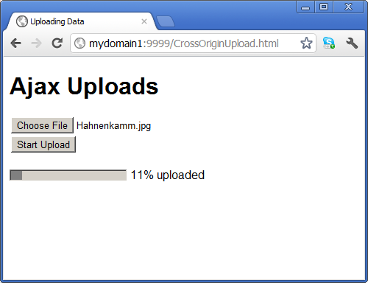
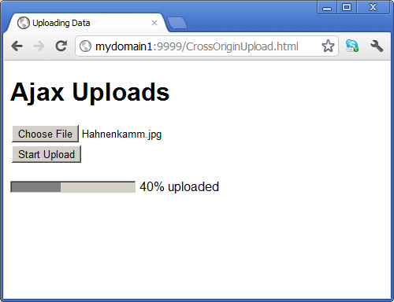
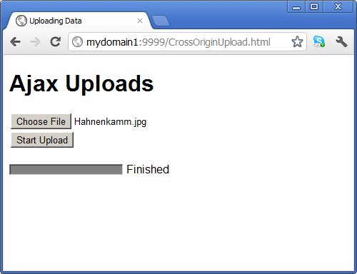
Running the Example
This is how the application appears when it's running:
Notes:
The example shows progress updates as a file is uploaded to the server, courtesy of Ajax Level 2 upload progress events.

Slide 21
Any Questions?

